Slide 1

8th Grade Math: Pre-Algebra
Unit 10, Lesson 1 Exploring Relations Volume 2, pg. 119

Slide 2


Benchmark
MA.8.F.1.1
Given a set of ordered pairs, a table, a graph, or mapping diagram, determine whether the relationship is a function. Identify the domain and range of the relation.
volume 2, pg. 119

Slide 3
Integrated Mathematical Thinking and Reasoning Standards
MA.K12.MTR.2.1 Demonstrate understanding by representing problems in multiple ways.
MA.K12.MTR.4.1 Engage in discussions that reflect on the mathematical thinking of self and others.
volume 2, pg. 119

Slide 4

Learning Target
I can recognize relations represented in different forms.
volume 2, pg. 119

Slide 5

Warm-Up
volume 2, pg. 119

Slide 6
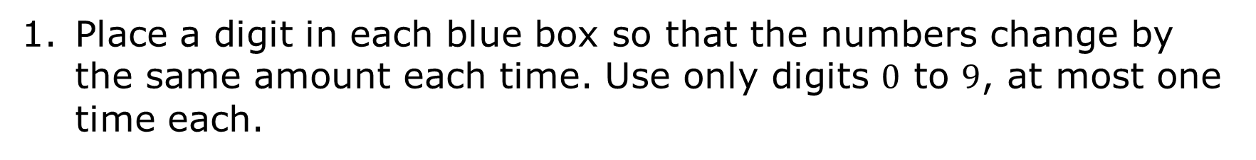
10.1.1 Warm-Up: Create a Pattern
Place a digit in each blue box so that the numbers change by the same amount each time. Use only digits $0$ to $9$, at most one time each.
, , , …
volume 2, pg. 119

Slide 7

Exploration
volume 2, pg. 120

Slide 8

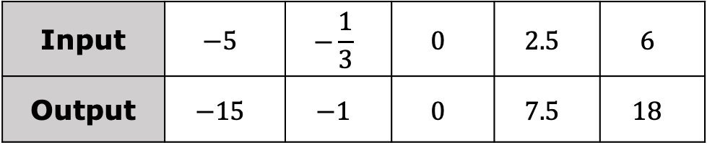
10.1.2 Exploration: Representing Mathematical Rules and Relations
An input-output rule is a rule that takes an input value and uses it to determine an output value.
input
rule
output
For example, in the table shown, a rule was used to get each output value from its corresponding input value.
Input | $$−5$$ | $$−\frac{1}{3}$$ | $$0$$ | $$2.5$$ | $$6$$
Output | $$−15$$ | $$−1$$ | $$0$$ | $$7.5$$ | $$18$$
volume 2, pg. 120

Slide 9
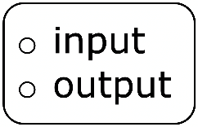
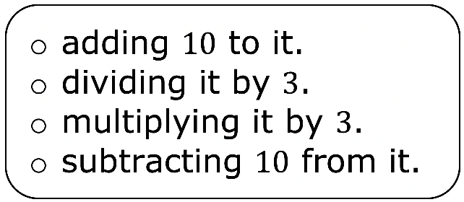
Work with your partner to determine the rule for the previous table. Then, complete the statement to describe the rule.
Each value is the result of taking the and
volume 2, pg. 120

Slide 10
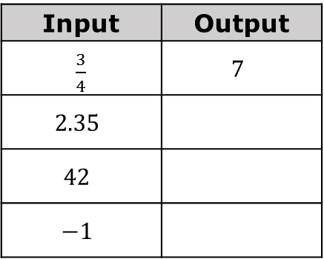




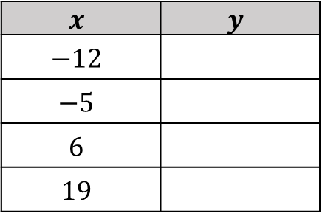
Work with your partner to complete the input-output table for each of the following rules. The first row has been completed as an example.
Rule | Table of Values
Input | Output
$\frac{3}{4}$ | $$7$$
$$2.35$$
$$42$$
$$−1$$
add $1$, then multiply
by $4$
input
output
write $1$ if the input is odd; write $0$ if the input is even
$$x$$ | $$y$$
$$−12$$
$$−5$$
$$6$$
$$19$$
$$x$$
$$y$$
volume 2, pg. 120

Slide 11

Each of the tables represent a relation.
A relation is a set of input-output pairs.
volume 2, pg. 120

Slide 12
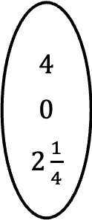
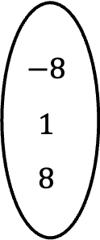
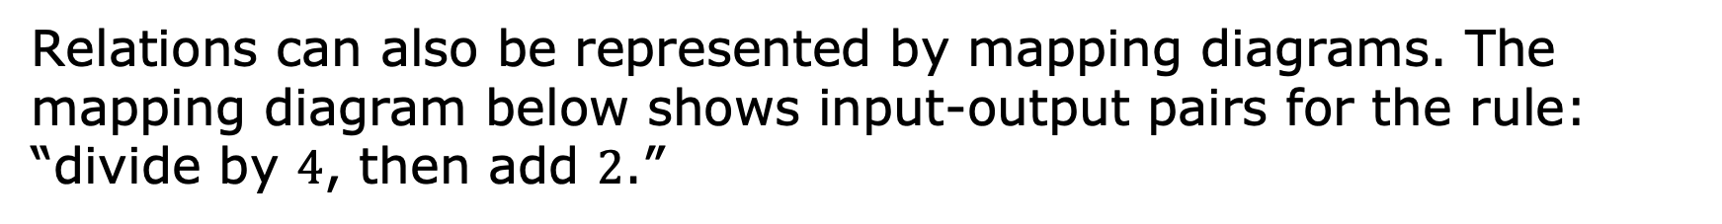
Relations can also be represented by mapping diagrams. The mapping diagram below shows input-output pairs for the rule: “divide by $4$, then add $2$.”
input output
$$−8$$
$$1$$
$$8$$
$$4$$
$$0$$
$2\frac{1}{4}$
volume 2, pg. 121

Slide 13
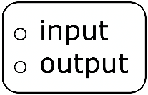
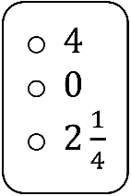
Work with your partner to complete the statements.
In a mapping diagram an is mapped to its corresponding using an arrow. In the previous mapping diagram above, the input 8 results in an output of for the relation shown.
volume 2, pg. 121

Slide 14
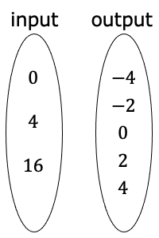
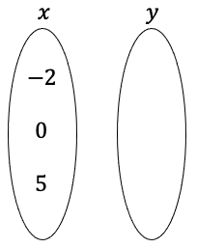



Work with your partner to complete the mapping diagram for each of the following rules.
Rule | Mapping Diagram
find the square root(s) of the input
input
output
subtract $3$, then multiply by $\frac{1}{2}$
$$x$$
$$y$$
volume 2, pg. 121

Slide 15
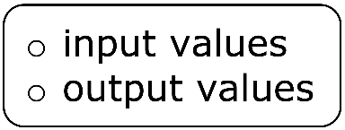
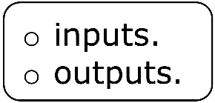
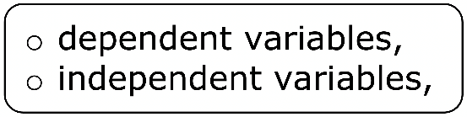
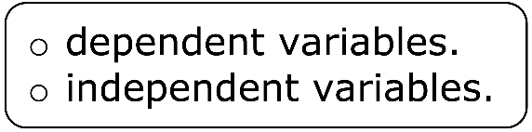
Complete the statements.
The of a relation depend on the values used for the Therefore, the inputs are the and the outputs are the
volume 2, pg. 121

Slide 16
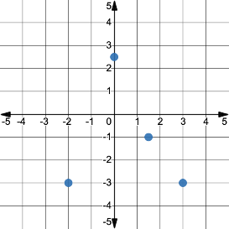
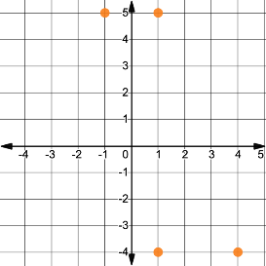




Relations can be represented using graphs.
For each relation below, its graph and mapping diagram are shown.
Relation | Mapping Diagram | Graph
Relation A
Relation B
$$−2$$
$$0$$
$$1.5$$
$$3$$
$$−1$$
$$−3$$
$\frac{5}{2}$
$$1$$
$$4$$
$$−1$$
$$−4$$
$$5$$
volume 2, pg. 122

Slide 17
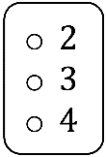
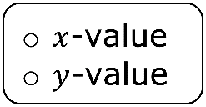
With your partner, discuss your observations when comparing the mapping diagrams and graphs for each relation.
Complete the statements.
The mapping diagram for each of the relations has input-output pairs indicated by arrows. The graph showing the same relation has points. The input value from the mapping diagram matches the of each point on the graph, and its corresponding output value from the mapping diagram matches the of each point on the graph.
volume 2, pg. 122

Slide 18
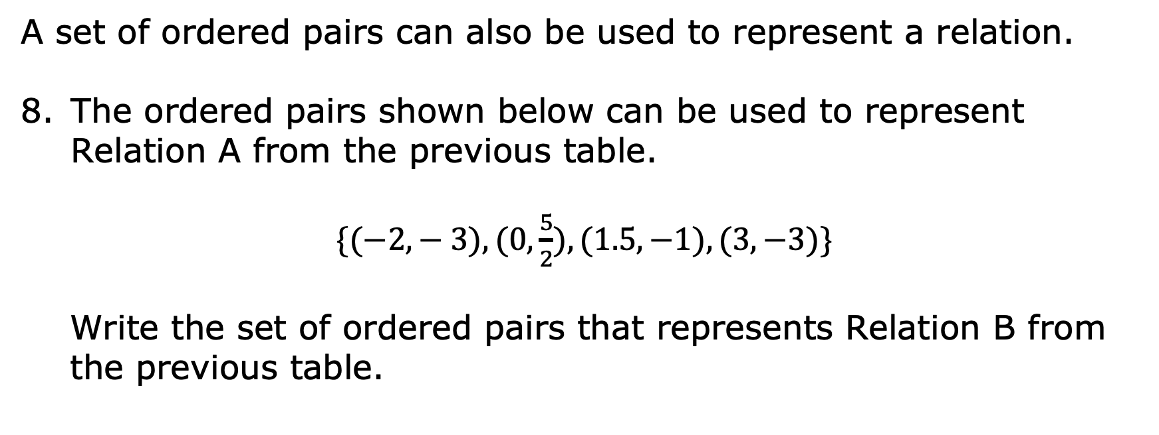
A set of ordered pairs can also be used to represent a relation.
The ordered pairs shown below can be used to represent Relation A from the previous table.
$\{(−2,− 3), (0, \frac{5}{2}), (1.5, −1), (3,−3)\}$
Write the set of ordered pairs that represents Relation B from the previous table.
volume 2, pg. 122

Slide 19

Bring It Together
volume 2, pg. 123

Slide 20

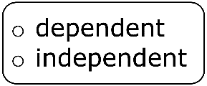
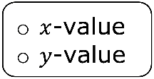
10.1.3 Bring It Together: Representing Relations
A relation is any set of input-output pairs. Relations can be represented using tables of values, mapping diagrams, a set of ordered pairs, or graphs.
Complete the statements.
In a relation, the input values are the variables. The input value is the of an ordered pair. The output values of a relation are the variables. The output value is the of the relation. The relation can be represented as a set of ordered pairs or on a graph.
volume 2, pg. 123

Slide 21

Wrap-Up
volume 2, pg. 123

Slide 22
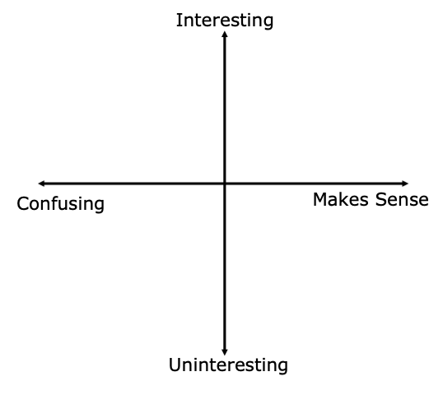
10.1.4 Wrap-Up: Reflection
Plot a point on the grid below to indicate your level of interest and understanding for today’s lesson.
volume 2, pg. 123

